Slide 1

Nguyen Long Thinh
10/2011

Slide 2

What’s new?
Notes:
This is 8 icon present the 8 main feature areas of HTML5 compare to HTML4 & XHTML.
HTML5 project start from 2004 under the name web 2.0 of WHATWG (Opera, Apple, Google, Mozzila). The draft working W3C in 2008.
2012: candidate recommendation
2022 (proposed recommendation)

Slide 3








AGENDA
BROWSER COMPATIBILITY
GeoLocation
Simplify Syntax
New Elements
Form 2.0
Drag drop
New Selector
Custom attribute
…
CSS3
App Cache
Local Storage
Video & Audio
Web Socket
Server-Sent Events
Web Messaging
Web Workers
Canvas
Notes:
SEMANTIC: Giving meaning to structure, semantics are front and center with HTML5. A richer set of tags, along with RDFa, microdata, and microformats, are enabling a more useful, data driven web for both programs and your users.
CSS3: CSS3 delivers a wide range of stylization and effects, enhancing the web app without sacrificing your semantic structure or performance. Additionally Web Open Font Format (WOFF) provides typographic flexibility and control far beyond anything the web has offered before.
Audio and video are first class citizens in the HTML5 web, living in harmony with your apps and sites.
CANVAS
GEOLOCATION
API

Slide 4
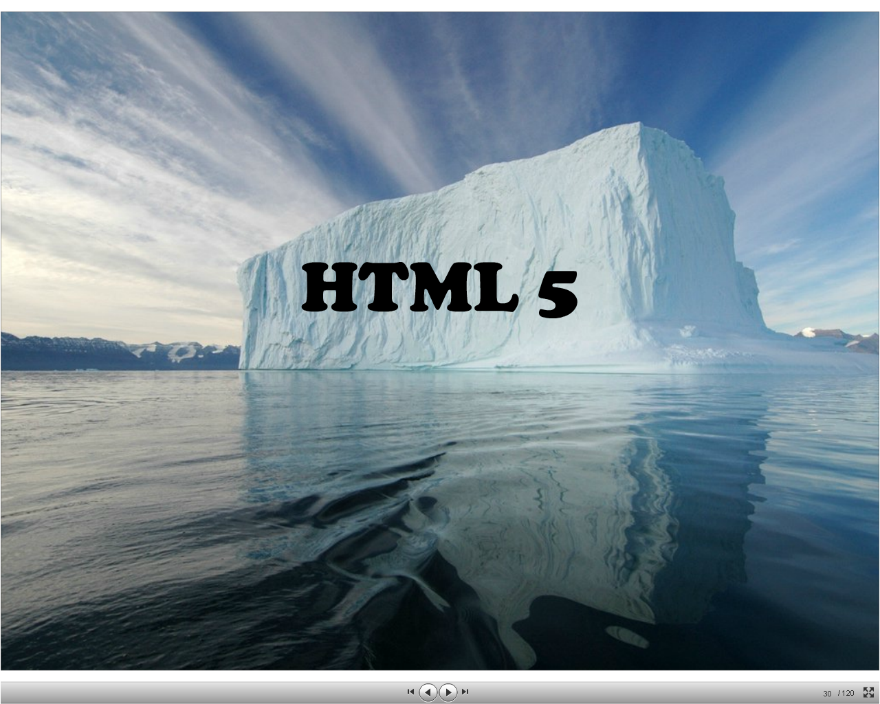
Language
<html><body>
<form>…</html>
Javascript API
var d = new Date()
getElementById()

Slide 5
HTML5 = HTML + JavaScript + CSS

Slide 6
simplify syntax

Slide 7
HTML 4
  <!DOCTYPE html PUBLIC "-//W3C//DTD XHTML 1.0 Strict//EN" "http://www.w3.org/TR/xhtml1/DTD/xhtml1-strict.dtd">
  <html xmlns=“http://www.w3.org/1999/xhtml”>
  <head>
  <meta http=equiv=“Content-Type” content=“text/html;charset=UTF-8”>
HTML 5
  <!doctype html>
  <html>
  <head>
  <meta charset=“utf-8”>

Slide 8
HTML5 add/redefined markup elements
header, footer, nav, section, aside …
Find list of new elements here
Notes:
The goad of implementing these commands is to minimize the use of <div> so that it becomes a “tag of last resort” - used only if no other tags are semantically appropriate.

Slide 9
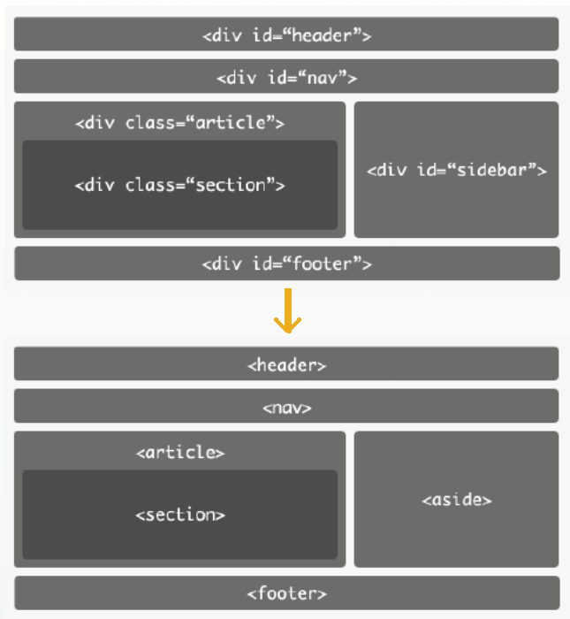
HTML 4.0
HTML 5

Slide 10
improved form elements more interactive form 2.0

Slide 11
rich form elements without JavaScript
<input type=“date”>
<input type=“time”>
<input type=“month”>
<input type=“week”>
<input type=“datetime”>
<input type=“range”>
<input type=“number”>
<input type=“file” multiple>
<input … autofocus>
<input … autocomplete>

Slide 12
built-in validation without JavaScript
<input type=“email”>
<input type=“url”>
<input type=“number” min=“1” max=“10”>
<input … required>
<input … pattern=“[a-z]{3}[0-9]{3}”>

Slide 13
new grammar of element declaration
<form id=“myform”>
<input type=“text”>
<input type=“submit”>
</form>
<form id=“myform”/>
<input type=“url” form=“myform”>
<input type=“submit” form=“myform” >

Slide 14
Demo Form 2.0

Slide 15
<video>

Slide 16
embed video with Flash
<object width="425" height="344">
<param name="movie" value="http://www.youtube.com/v/9sEI1AUFJKw&hl=en&fs=1&"></param>
<param name="allowFullScreen" value="true"></param>
<param name="allowscriptaccess" value="always"></param>
<embed src="http://www.youtube.com/v/9sEI1AUFJKw&hl=en&fs=1&" type="application/
x-shockwave-flash" allowscriptaccess="always" allowfullscreen=
"true" width="425" height="344"></embed>
</object>

Slide 17
<video src="video.webm"></video>

Slide 18
<video src="video.webm“ controls autoplay loop preload="none" poster="poster.jpg" width="320" height="240">
<a href="video.webm">Download movie</a>
</video>
Notes:
Control: show built-in player control
Autoplay: autoplay video on page load
Loop: play video again and again
Preload: load video stream when page loaded
Poster: image shown when video file not available

Slide 19
<video src="video.webm” id=“player”></video>
… var v = document.getElementById('player'); v.play(); v.pause(); v.volume = … ; v.currentTime = … ;
control video with JavaScript

Slide 20
<video src="video.webm” id=“player”></video>
… var v = document.getElementById('player'); v.addEventListener('loadeddata', function() { … }, true) v.addEventListener('play', function() { … }, true) v.addEventListener('pause', function() { … }, true) v.addEventListener('timeupdate', function() { … }, true) v.addEventListener('ended', function() { … }, true)
event fired by <video>

Slide 21
<video src="video.webm”id=“player”>
<source src=“movies.mp4” type=“video/mp4”/>
<source src=“movies.webm” type=“video/webm”/>
<source src=“movies.ogv” type=“video/ogg”/>
Your browser do not support video
</video>
provide multiple sources

Slide 22
<video src="video.webm”id=“player”>
<source src=“movies.mp4” type=“video/mp4”/>
<source src=“movies.webm” type=“video/webm”/>
<source src=“movies.ogv” type=“video/ogg”/>
<object width="…" height="…" type="application/x-shockwave-flash" data="player.swf">
<param name="movie" value="player.swf" />
<param name="flashvars" value=" … file=movie.mp4" />
Your browser do not support video
</object>
</video>
provide multiple sources

Slide 23
<audio>

Slide 24
<audio controls autoplay
<source src=“music.mp3” type=“audio/mpeg”/>
<source src=“music.oga” type=“audio/ogg”/>
</audio>
<audio> exactly the same as <video>
Notes:
Control: show built-in player control
Autoplay: autoplay video on page load
Loop: play video again and again
Preload: load video stream when page loaded
Poster: image shown when video file not available

Slide 25
<canvas>

Slide 26
canvas = “scriptable images”
<canvas width=“..” height=“..”></canvas>

Slide 27
standard API for drawing
<canvas width=“..” height=“..” id=“mycanvas”></canvas>
...
var canvas = document.getElementById(“mycanvas”);
var pencil = canvas.getContext(“2d”);
pencil.fillRect(x, y, w, h);
pencil.moveTo(x, y);
pencil.lineTo(x, y);
pencil.bezierCurveTo(x1, y1, x2, y2, c1, c2);
pencil.arc(x, y, r, startAngle, endAngle, anticlockwise);
pencil.fillText(“text to draw”, x, y);
pencil.createLinearGradient(x1, y1, x2, y2);

Slide 28
context attribute
pencil.strokeStyle = “#00FF00”;
pencil.fillStyle = “#00FF00 | gradientObj”;
pencil.font = "bold 12px sans-serif";
pencil.textBaseLine = “top | right | bottom | left”;

Slide 29
draw image
var myImage = new Image();
myImage.src = “images/logo.png”;
pencil.drawImage(myImage, x, y);
...
var el = document.getElementById(“imgObj|videoObj”);
pencil.drawImage(el, x, y);
Notes:
imageObj : draw image form <img src=“”/>
videoOjb: capture current image from video tag

Slide 30
Demo Canvas

Slide 31
GeoLocation
navigator.geolocation.getCurrentPosition(success, error);
navigator.geolocation.watchCurrentPosition(success, error);
function success(position) {
var lat = position.coords.latitude;
var long = position.coords.longitude;
...
}
Demo:http://html5demos.com/geo

Slide 32
offline & storage
application cache
localStorage/sessionStorage

Slide 33
application cache
<html manifest=”blah.manifest”>
CACHE MANIFEST
images/sprites.png
scripts/common.js
scripts/jquery.js
styles/global.css
NETWORK:
# never cached (apart from normal caching mechanism)
onlineonly.css
FALLBACK:
# pattern matching. fallback file will also be cached
images/ images/not-offline.png
Notes:
In order for the offline applications to work, a cache manifest file must be created by the web developer. If the web application exceeds more than one page then each page must have a manifest attribute that points to the cache manifest. The cache manifest file is a text file located in another part of the server. It must be served with the following content type
This manifest file lists three resources: a CSS file, a JavaScript file and a PNG image. When the above file is loaded, the browser will download the test.css, test.js and test.png files from the root directory in the web server.[1] As a result, whenever your network is not connected, the resources will be available to you offline.
CACHE MANIFEST
Cache item list
NETWORK
The resources listed under this section are never cached and are not available offline
FALLBACK
The fallback section in a cache manifest file can be used to substitute online resources that cannot be cached or were not cached successfully

Slide 34
localStorage/ sessionStorage
localStorage.setItem(key, value);
localStorage.getItem(key);
localStorage.clear();
localStorage.key = value;
if(localStorage.key == ‘…’){…}
localStorage – visible to all windows load from same domain. Persistent after browser close
sessionStorage – stored in window object, deleted on close
Notes:
Web storage offers two different storage areas—local storage and session storage—which differ in scope and lifetime.
Data placed in local storage is per domain (it's available to all scripts from the domain that originally stored the data) and persists after the browser is closed.
Session storage is per-page-per-window and is limited to the lifetime of the window. Session storage is intended to allow separate instances of the same web application to run in different windows without interfering with each other, a use case that's not well supported by cookies
Some preference code:
if (typeof(localStorage) == 'undefined' ) {
alert('Your browser does not support HTML5 localStorage. Try upgrading.');
} else {
try {
localStorage.setItem("name", "Hello World!"); //saves to the database, "key", "value"
} catch (e) {
if (e == QUOTA_EXCEEDED_ERR) {
alert('Quota exceeded!'); //data wasn't successfully saved due to quota exceed so throw an error } }
document.write(localStorage.getItem("name")); //Hello World! localStorage.removeItem("name"); //deletes the matching item from the database }

Slide 35
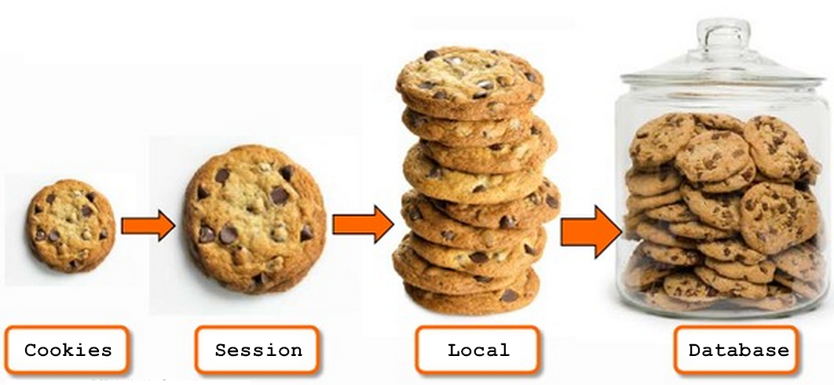

Slide 36
new selector
var el = document.getElementById(targetId');
var els = document.getElementsByTagName('div');
var els = document.getElementsByClassName('section');
var els = document.querySelector(“#targetId");
var els = document.querySelector(“.section");
var tds = document.querySelectorAll("table.test > tr > td");
var el = document.querySelector("table.test > tr > td");
// el == tds[0]
Notes:
# == id
. == class

Slide 37
Custom data-* attribute
Define, store, and retrieve custom data on the DOM.
<div id="out" data-id="good" data-name="joe“ data-screen-name="user1"></div>
var el = document.querySelector('#out');
  alert(el.dataset[‘id’]);
// Add new data attributes via JS.
  el.setAttribute('data-foo', 'bar');
  var html = [];
  for (var key in el.dataset) {
  html.push(key, ': ', el.dataset[key], '<br>');
  }
  el.innerHTML = html.join('');
Result:
id: good name: joe screenName: user1 foo: bar
Notes:
# == id
. == class

Slide 38
web messaging

Slide 39
cross domain communication
Sender:
var win = document.getElementById("iframe").contentWindow;
win.postMessage(“my message”,"http://targetDomain.com" );
Receiver:
window.onmessage = function(e){
if ( e.origin !== "http://sourceDomain.com" ) {
return;
}
var recvMessage = e.data;
// handle the message ...
};
Demo: http://html5demos.com/postmessage2
Notes:
Syntax:
otherWindow.postMessage(message, targetOrigin);
message
Data to be sent to the other window (string)
targetOrigin
The origin of the window that sent the message at the time postMessage was called

Slide 40
web worker
Notes:
The Web Workers specification defines an API for spawning background scripts in your web application but without blocking the UI or other scripts to handle user interactions
They're going to help put and end to that nasty 'unresponsive script' dialog that we've all come to love.

Slide 41
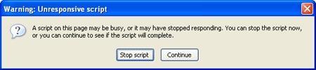
Threading in JavaScript
bottlenecks
setTimeout()
setInterval()
XMLHttpRequest()
Previously, JavaScript is a single-thread environment
HTML5:
Concurrency script executing
Asynchronous events
Notes:
There are a number of bottlenecks preventing interesting applications from being ported to client-side JavaScript. Some of these include browser compatibility, static typing, accessibility, and performance. Fortunately, the latter is quickly becoming a thing of the past as browser vendors rapidly improve the speed of their JavaScript engines.
JavaScript is a single-threaded environment, meaning multiple scripts cannot run at the same time. As an example, imagine a site that needs to handle UI events, query and process large amounts of API data, and manipulate the DOM. Unfortunately all of that can't be simultaneous due to limitations in browsers' JavaScript runtime. Script execution happens within a single thread
Developers mimic 'concurrency' by using techniques like setTimeout(), setInterval(), XMLHttpRequest, and event handlers. Yes, all of these features run asynchronously, but non-blocking doesn't necessarily mean concurrency. Asynchronous events are processed after the current executing script has yielded. The good news is that HTML5 gives us something better than these hacks!

Slide 42
web worker
main.js
var worker = new Worker('doWork.js');
// start worker with data string = “Hello World”
worker.postMessage('Hello World');
//worker.postMessage({text: ‘hello’});
//handle worker response
worker.addEventListener('message', function(e) { alert('Worker said: ', e.data);
}, false);
doWork.js
self.addEventListener('message', function(e){
self.postMessage(e.data); // response received data
}, false);
Notes:
The Web Workers specification defines an API for spawning background scripts in your web application but without blocking the UI or other scripts to handle user interactions
They're going to help put and end to that nasty 'unresponsive script' dialog that we've all come to love.
Web Workers run in an isolated thread. As a result, the code that they execute needs to be contained in a separate file. But before we do that, the first thing to do is create a new Worker object in your main page. The constructor takes the name of the worker script:
If the specified file exists, the browser will spawn a new worker thread, which is downloaded asynchronously. The worker will not begin until the file has completely downloaded and executed. If the path to your worker returns an 404, the worker will fail silently.
When postMessage() is called from the main page, our worker handles that message by defining an onmessagehandler for the message event. The message payload (in this case 'Hello World') is accessible in Event.data. Although this particular example isn't very exciting, it demonstrates that postMessage() is also your means for passing data back to the main thread. Convenient!
Messages passed between the main page and workers are copied, not shared

Slide 43
worker scope
Features Available to Workers
  The navigator object
  The location object (read-only)
  XMLHttpRequest
  setTimeout()/clearTimeout() and setInterval()/clearInterval()
  The app cache
  Importing external scripts using the importScripts() method
  Spawning other web workers to create worker farm. Be careful: this may make user’s system out of resources.
Notes:
Messages passed between the main page and workers are copied, not shared
Workers have the ability to spawn child workers. This is great for further breaking up large tasks at runtime. However, subworkers come with a few caveats:
Subworkers must be hosted within the same origin as the parent page.
URIs within subworkers are resolved relative to their parent worker's location (as opposed to the main page).
Keep in mind most browsers spawn separate processes for each worker. Before you go spawning a worker farm, be cautious about hogging too many of the user's system resources. One reason for this is that messages passed between main pages and workers are copied, not shared. See Communicating with a Worker via Message Passing.

Slide 44
worker scope
Workers can NOT access to
  The DOM (it's not thread-safe)
  The window object
  The document object
  The parent object
Notes:
Messages passed between the main page and workers are copied, not shared

Slide 45
inline web worker
main.js
<script id="worker1" type="javascript/worker">
// This script won't be parsed by JS engines because its type is javascript/worker.
self.onmessage = function(e) {
self.postMessage('msg from worker');
};
</script>
<script>
var bb = new BlobBuilder(); bb.append(document.querySelector('#worker1').textContent);
var worker = new Worker(window.URL.createObjectURL(bb.getBlob()));
// Note: window.webkitURL.createObjectURL() in Chrome 10+.
worker.onmessage = function(e) {
alert("Received: " + e.data);
}
worker.postMessage(); // Start the worker.
</script>
Notes:
With the new BlobBuilder interface, you can "inline" your worker in the same HTML file as your main logic by creating a BlobBuilder and appending the worker code as a string
The magic comes with the call to window.URL.createObjectURL(). This method creates a simple URL string which can be used to reference data stored in a DOM File or Blob object.
Blob URLs are unique and last for the lifetime of your application (e.g. until the document is unloaded). If you're creating many Blob URLs, it's a good idea to release references that are no longer needed. You can explicitly release a Blob URLs by passing it to window.URL.revokeObjectURL():
Loading External Scripts
<script id="worker2" type="javascript/worker">
self.onmessage = function(e) {
var data = e.data;
if (data.url) {
var url = data.url.href;
var index = url.indexOf('index.html');
if (index != -1) {
url = url.substring(0, index); }
importScripts(url + 'engine.js');
}
... };
</script>
<script>
var worker = new Worker(window.URL.createObjectURL(bb.getBlob()));
worker.postMessage({url: document.location});
</script>

Slide 46
error handling with web worker
var worker = new Worker('worker.js');
worker.addEventListener('error', function(e){
alert(
'ERROR: Line ‘ + e.lineno
+ ' in ‘ + e.filename
+ ':‘ + e.message
);
}, false);

Slide 47
Demo Web Worker

Slide 48
etc
online/offline detect, drag & drop, microdata, fileWriter, Indexed Database, itemProp, sandbox (on iframes), datagrid, XHR2, ARIA overlap, notification, file API, device orientation, speech input (chrome) <datalist> , <ruby>, <meter>, <progress>…

Slide 49
browser compatibility

Slide 50
Not everything works in every browsers
Notes:
The HTML5 spec is not finished yet. It’s is still in draft.

Slide 51
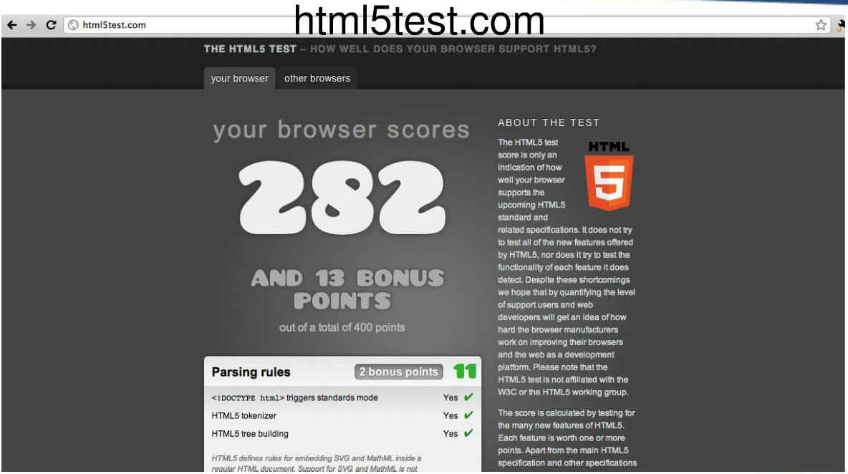
evaluation

Slide 52
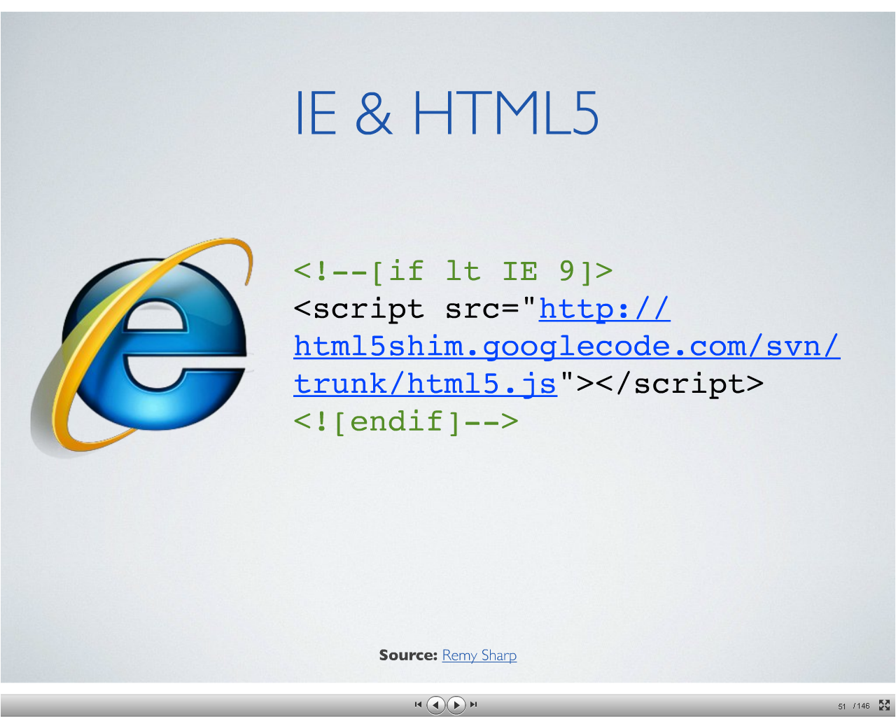
patching
excanvas,js
html5shiv (google code)
html5media

Slide 53
Exercises 1
A Web shop wants to sell ice cream online. They offer 5 different kinds of toppings: sprinkles, chocolate chips, strawberry syrup, banana flakes, and caramel sauce. Toppings are chosen using 5 checkboxes. However, some constraints apply:
at most three toppings may be selected
strawberry syrup and caramel sauce cannot both be chosen (too messy!)
Write an HTML document with the form and JavaScript code to continuously enforce the constraints. If the current data in the form is invalid, the user is notified by an appropriate message somewhere on the page and clicking 'submit' will result in an alert window popping up rather than the data being submitted to the server (assuming that the browser does execute the JavaScript code).

Slide 54
Exercises 2
The Fun Sorting Game: Make an HTML5 page with JavaScript code with the following functionality: The page contains a list of 10 random numbers. The user must then sort the list using drag-and-drop. When the numbers are sorted, a new game is started. Use the HTML5 local storage mechanism to keep track of the number of games played by the user, and show this number somewhere on the page.

Slide 55
Preference
http://en.wikipedia.org/wiki/HTML5
http://en.wikipedia.org/wiki/HTML5_video
http://en.wikipedia.org/wiki/Cache_manifest_in_HTML5
http://www.w3schools.com/html5/html5_reference.asp
http://www.w3.org/TR/html5-diff/
http://www.html5rocks.com/en/tutorials/workers/basics/
http://slides.html5rocks.com
http://html5demos.com/
http://dev.w3.org/html5/webdatabase/
http://www.w3.org/html/logo/
www.html5test.com
http://www.canvasdemos.com
http://alteredqualia.com/canvasmol/

Slide 56
THANK
YOU

